Slide 1
Chapter 3
Linked Lists
Data Structure
Software College Northeastern University

Slide 2

Overview
Linked Lists
Programming details
Circularly Linked Lists
Doubly Linked Lists
Cursors Implementation of Linked Lists
Applications
Multilists
Data Structure
Software College Northeastern University

Slide 3
Variable-length arrays?
Direct access to element (By indexing)
Array size is fixed-length
-To expand them, you create a new, longer array, and copy the contents of the old array into the new array
  This is used by function realloc() in C
  This is slow!
Linear time Insertion/Removal due to shift elements
  due to contiguous storage in memory
  Half of the list needs to be moved for either operations
Data Structure
Software College Northeastern University

Slide 4
Variable-length arrays?
Solution:
-The list is not need to store contiguously.
-Attach a pointer to each item in the array, which points to the next item.
-provides the ability to add or remove the items anywhere in the list in constant time
  This is a linked list
  Linked lists are unbounded
  (maximum number of items limited only by memory)
Data Structure
Software College Northeastern University

Slide 5
The Linked List data structure
array
[0]
[1]
[2]
Array
A
B
C
node
head
Linked list
A
B
C
An data item plus its pointer is called a node
A node contains data item and one or more links.
- The link is a reference to a node.
- The link of last node is set to NULL
a “head” which is a pointer to the first node in the
linked list
Data Structure
Software College Northeastern University

Slide 6
A simple single Linked List
Address
Data Item
Links
Header
1
LI
43
7
QIAN
13
H
13
SUN
1
31
19
WANG
NULL
25
WU
37
31
ZHAO
7
37
ZHENG
19
43
ZHOU
25
H
ZHAO
QIAN
SUN
LI
ZHOU
WU
ZHENG
WANG
^
Data Structure
Software College Northeastern University

Slide 7
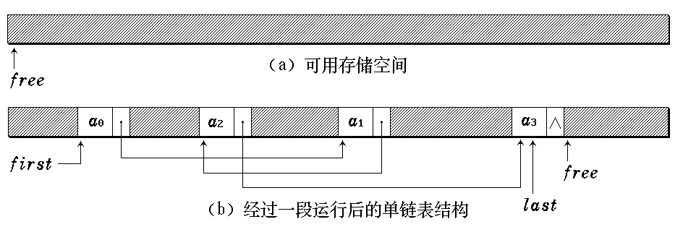
Memory Storage of linked list
Heap
We can access all nodes through pointer “head”
Data Structure
Software College Northeastern University

Slide 8
Linked lists
Each node contains the address of the next one in the list.
We can access the first node through pointer “head”
two important pointer:
- head: the reference to the first node
- tail: the reference to the last node
Data Structure
Software College Northeastern University

Slide 9
Overview
Linked Lists
Programming details
Circularly Linked Lists
Doubly Linked Lists
Cursors Implementation of Linked Lists
Applications
Multilists
Data Structure
Software College Northeastern University

Slide 10
How to implementate?
？
Data Structure
Software College Northeastern University

Slide 11
Definition of the class
Using multi class
  Class of Node(ListNode)
  Class of LinkedList
  Class of Iterator
Type of Definition
  compound
  inside
Data Structure
Software College Northeastern University

Slide 12
class ListNode<Type> {
Type data;
ListNode<Type> link;
}
public class List<Type> {
private ListNode<Type> first;
private ListNode<Type> last;
…
}
ListNode is a class outside List
Data Structure
Software College Northeastern University

Slide 13
class LinkedList<Type> {
private static class ListNode<Type> {
public Type data;
public ListNode<Type> link;
}
private ListNode<Type> first;
private ListNode<Type> last;
…
}
ListNode is a class inside List
Data Structure
Software College Northeastern University

Slide 14
Linked List:Inserting a new node(1)
public int insert ( final Type x, final int i )
  Insert a node with data x after the i-1’th element. (i.e., when i = 0, insert the node as the first element; when index = 1, insert the node after the first element, and so on)
  If index is < 0 or > length of the list, the insertion will fail.
Steps
  Locate i-1’th element
  Allocate memory for the new node
  Link the new node to its successor
  Link the new node’s predecessor to the new node
i’th element
newNode
Data Structure
Software College Northeastern University

Slide 15
Linked List:Inserting a new node(2)
Insert position
  Case 1：Insert in front of the first node
newnode.link = first;
first = newnode;
newnode
newnode
first
first
（Before） （After）
Data Structure
Software College Northeastern University

Slide 16
Linked List:Inserting a new node(3)
  Case 2：Insert in the middle of the list
  newnode.link = p.link;
p.link = newnode；
newnode
newnode
p
p
（Before） （After）
Data Structure
Software College Northeastern University

Slide 17
Linked List:Inserting a new node(4)
  Case 3：Insert in the rear
  newnode.link = p.link;
p.link = last = newnode；
newnode
newnode
p
p
last
last
（Before） （After）
Data Structure
Software College Northeastern University

Slide 18
Linked List:Inserting a new node(5)
From 0
public void insert ( final Type x, final int i ) {
// Insert a node with data x after the i-1’th
ListNode<Type> p = first; int k = 0;
while ( p != null && k < i -1 ){
p = p.link; k++; } // Locate i-1’th element
if ( i<0 || p == null && i != 0 )
throw new java.util.NoSuchElementException();
ListNode<Type> newnode = new ListNode(x, null);
// Allocate memory for the new node
Data Structure
Software College Northeastern University

Slide 19
Linked List:Inserting a new node(6)
if (i == 0 ) { //Insert in the front of list
newnode.link = first;
first = newnode;
}
else { //else
newnode.link = p.link;
p.link = newnode;
}
if(newnode.link==null) last=newnode;
}
Data Structure
Software College Northeastern University

Slide 20
Linked List:Inserting a new node
when we insert a new node：
（1）insert before the i’th element，
which reference should we get first？
（2）illegal inserting position is ?
How can we judge inserting position is illegal？
（3）We should change two links when inserting ，
Is there an order？
？
Data Structure
Software College Northeastern University

Slide 21
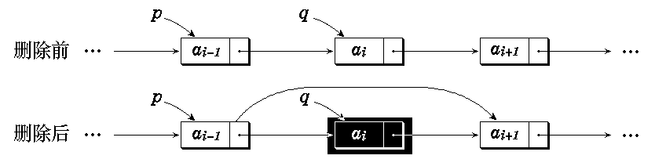
Linked List:Deleting a new node(1)
According the link to i’th element ,Can we accomplish the operation？
Case 1: delete the first
Case 2: delete the other node
Delete the i’th element
Data Structure
Software College Northeastern University

Slide 22
Linked List:Deleting a new node(2)
public Type remove( int i ) {
//Delete the i’th element
Node<Type> p = first, q;
while ( p != null && k< i-1 ){
p = p.link; k++; } //locate the i-1’th element
if (i<0 || p == null || p.link == null )
throw new java.util.NoSuchElementException();
if ( i == 0 ) { //delete the first
q = first; //q point the deleted node
p = first = first.link; //update first
}
Data Structure
Software College Northeastern University

Slide 23
Linked List:Deleting a new node(3)
else {
q = p.link;
p.link = q.link;
}
if ( q == last ) last = p; //if necessary update last
Type k = q.data;
return k;
}
Data Structure
Software College Northeastern University

Slide 24
Linked List with header
A node linking to the first node is called Header, the header cell only contains references to the first.
first
a₁
a_{n}
0
first
0
last
last
Non-empty list empty list
Data Structure
Software College Northeastern University

Slide 25
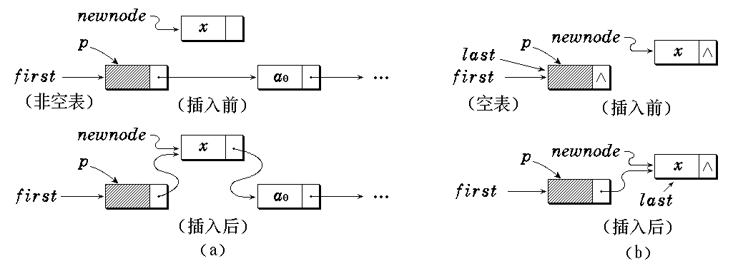
Inserting in a linked list with header
newnode.link = p.link;
p.link = newnode;
if(newnode.link==null) last=newnode;
Data Structure
Software College Northeastern University

Slide 26
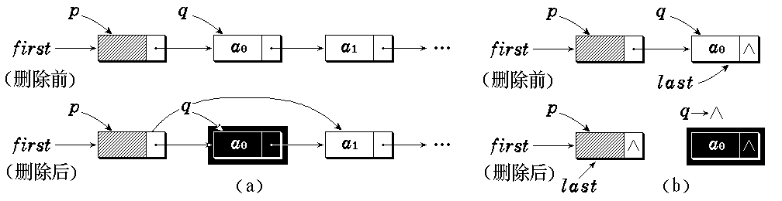
Deleting in a linked list with header
q = p.link;
p.link = q.link;
if ( p.link == null ) last = p;
Data Structure
Software College Northeastern University

Slide 27
Implementation of linked list
class ListNode<Type> {
Type data; //结点数据
ListNode<Type> link; //下一结点引用
public ListNode ( ){ //链表结点构造函数
link = null;
}
public ListNode ( Type item ){
data = item;
link = null;
}
public ListNode(Type item, ListNode<Type> node){
data = item;
link = node;
}
public ListNode<Type> nextNode ( ) {
return link;
}
Data Structure
Software College Northeastern University

Slide 28
Implementation of linked list
public void insertAfter ( ListNode<Type> p ){
//在当前结点后插入结点p
p.link = link;
link = p;
}
public ListNode<Type> removeAfter( ){
//摘下当前结点的下一结点
ListNode<Type> temp = link;
if ( link == null ) return null;
//没有下一结点则返回空
link = temp.link; //重新链接
return temp; //返回删除的结点
}
}
Data Structure
Software College Northeastern University

Slide 29
Implementation of linked list
public class LinkedList<Type> {
ListNode<Type> first;
ListNode<Type> last;
int size;
public void clear(){
last = first = new LinkNode<Type>();
size = 0;
}
public List(){
clear();
}
public size(){
return size;
}
Data Structure
Software College Northeastern University

Slide 30
Implementation of linked list
public ListNode<Type> Find(int i){
if(i < -1) return null;
if(i==-1) return first;
ListNode<Type> p = first.link;
int j = 0;
while( p != null && j<i){ //Find the ith node
p=p.link;
j++;
}
return p;
}

Slide 31
Implementation of linked list
public ListNode<Type> Find(Object o){
if(o==null){
for(ListNode<Type> p=first.link; p!=null; p=p.link)
if(p.data == null) return p;
} else{
for(ListNode<Type> p=first.link; p!= null; p=p.link)
if(o.equals(q.data)) return p;
}
return null;
}
Data Structure
Software College Northeastern University

Slide 32
Implementation of linked list
public int insert( Type value, int i ) {
//将含value的新元素插入到链表第 i 个位置
ListNode<Type> p = Find ( i-1 );
// p 指向链表第 i-1个结点
if ( p == null ) return 0;
ListNode<Type> newnode = //创建结点
new ListNode<Type>( value, p.link );
if ( p.link == NULL ) last = newnode;
p.link = newnode; //重新链接
return 1;
}
Data Structure
Software College Northeastern University

Slide 33
Implementation of linked list
public Type remove(int i){
//从链表中删去第 i 个结点
ListNode<Type> p = Find (i-1);
if ( p == null || p.link == null)
return null;
ListNode<Type> q = p.link;
p.link = q.link; //重新链接
if ( q == last ) last = p;
return q.data;
}
Data Structure
Software College Northeastern University

Slide 34
Implementation of linked list
public Type get( int i) {
//提取第 i 个结点的数据
ListNode<Type> p = find( i );
// p 指向链表第 i 个结点
if ( p ==null || p == first )
return null;
else return p.data;
}
Data Structure
Software College Northeastern University

Slide 35
Implementation of linked list
public Type set(int i, Type value) {
ListNode<Type> p = find(i);
if(p==null || p==first) return null;
Type oldVal = p.data;
p.data = value;
return oldVal;
}
Data Structure
Software College Northeastern University

Slide 36
Array versus Linked Lists
Linked lists are more complex to code and management than arrays, but they have some distinct advantages.
  Dynamic: a linked list can easily grow and shrink in size.
    -We don’t need to know how many nodes will be in the list. They are created in memory as needed.
    -In contrast, the size of an array is fixed.
  Easy and fast insertions and deletions
    -To insert or delete an element in an array, we need to copy to temporary variables to make room for new elements or close the gap caused by deleted elements.
    -With a linked list, no need to move other nodes. Only need to reset some references.
Data Structure
Software College Northeastern University

Slide 37
Arrays versus linked lists
Space (storage) considerations
  A linked list requires references to nodes
  An array requires the maximum number of elements to be known in advance. If that maximum is not required, space is wasted at the end of the array.
Data Structure
Software College Northeastern University

Slide 38
Arrays versus linked lists
Time considerations
  Most methods in a linked list require more statements than those in an array, which may indicate more time required
  Arrays are quicker at finding and altering
  ‘in the middle’
  Linked lists are quicker at additions and removals ‘in the middle’
Data Structure
Software College Northeastern University

Slide 39
Iterator class of list
Iterator class of list is used to traverse data of containers, such as ArrayList or LinkedList.
priciple：
  Iterator of a LinkedList is used to access its data elements one by one;
  Data member current reference to the node currently used;
  Iterator privides some test and find operation.
Data Structure
Software College Northeastern University

Slide 40
Iterator class of list
class ListNode<Type>{
Type data;
ListNode<Type> link;
...
}
public class LinkedList<Type>{
ListNode<Type> first;
ListNode<Type> last;
int size;
...
}
Data Structure
Software College Northeastern University

Slide 41
Iterator class of list
public class ListIterator<Type>{
private LinkedList<Type> list;
private ListNode<Type> current;
public Type begin(){ //Initial the current member
current = list.first.link;
}
public boolean hasNext(){
if(current!=null) return true;
else return false;
}
Data Structure
Software College Northeastern University

Slide 42
Iterator class of list
public Type getData(){
if(current==null)
throw new java.util.NoSuchElementException();
else
return current.data;
}
public void next(){ //get the current element
if(!hasNext())
throw new java.util.NoSuchElementException();
current = current.link;
}
…
}
Data Structure
Software College Northeastern University

Slide 43
Calculating using iterator
public int sum ( LinkedList<integer> l ) {
ListIterator<integer> iter =
new ListIterator<integer>(l);
iter.begin( );
int retval = 0;
integer p;
while (iter.hasNext()){ //the current element exist
p= li.getData( );
retval += p.intValue();
li.next();
}
return retval;
}
Data Structure
Software College Northeastern University

Slide 44
Overview
Linked Lists
Programming details
Circularly Linked Lists
Doubly Linked Lists
Cursors Implementation of Linked Lists
Applications
Multilists
Data Structure
Software College Northeastern University

Slide 45
Variations of Linked Lists
Two problems
- we can’t get back to the beginning of the list
- from the end, and we can’t go backwards through the list.
So, circular linked lists and doubly linked lists were invented.
Data Structure
Software College Northeastern University

Slide 46
Variations of Linked Lists
Circular linked lists
  The last node points to the first node of the list
  How do we know when we have finished traversing the list? (Tip: check if the reference of the current node is equal to the head.)
A
B
head
Data Structure
Software College Northeastern University

Slide 47
Implementation of Circular linked lists(1)
class CircListNode<Type> {
private Type data;
private CircListNode<Type> link;
public CircListNode(){
data = null;
link = null;
}
public CircListNode(Type d){
data = d;
link = null;
}
public CircListNode ( Type d, CircListNode<Type> next){
data = d;
link = next;
}
}
Data Structure
Software College Northeastern University

Slide 48
Implementation of Circular linked lists(2)
public class CircList<Type> {
private CircListNode<Type> first;
private CircListNode<Type> current;
public CircList(){…}
public int size( ) {…}
public boolean isEmpty( ){
return first.link == first;
}
public bool find (Type value ) {…}
public Type getData ( ) {…}
public Type first ( ) {…}
public Type next ( ) {…}
Data Structure
Software College Northeastern University

Slide 49
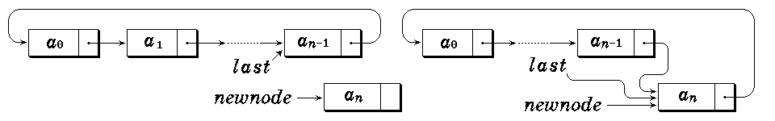
Implementation of Circular linked lists(3)
public boolean hasNext ( ) {…}
public void insert (Type value) {…}
public void remove ( ) {…}
…
}
Insert
Data Structure
Software College Northeastern University

Slide 50
Variations of Circular Linked Lists
Circular linked lists
  construct an empty Circular linked list
public List () {
first = new ListNode<Type>( value );
}
public CircList () {
first = new CircListNode<Type>();
first.link = first;
}
Data Structure
Software College Northeastern University

Slide 51
Linked Lists: Searching in a CLL
public CircListNode<Type> find ( Object o) {
//在链表中从头搜索其数据值为value的结点
CircListNode<Type> p = first.link;
if(o==null)
while ( p != first && p.data != null )
p = p→link;
else
while ( p != first && !o.equals(p.data))
p = p→link;
return (p!=first)?p:null;
}
Data Structure
Software College Northeastern University

Slide 52
Overview
Linked Lists
Programming details
Circularly Linked Lists
Doubly Linked Lists
Cursors Implementation of Linked Lists
Applications
Multilists
Data Structure
Software College Northeastern University

Slide 53
Variations of Linked Lists
Doubly linked lists
  Each node points to not only successor but the predecessor
  There are two null: at the first and last nodes in the list
  Advantage: given a node, it is easy to visit its predecessor. Convenient to traverse lists backwards
∅
A
B
∅
Head
Data Structure
Software College Northeastern University

Slide 54

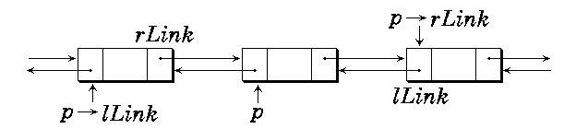
Doubly linked lists
Non_empty list empty list
p == p.lLink.rLink == p.rLink.lLink
Data Structure
Software College Northeastern University

Slide 55
Implementation of Doubly linked lists
class DblNode<Type>{
Type data;
DblNode<Type> lLink;
DblNode<Type> rLink;
public DblNode( ){
data = null;
lLink = rLink = null;
}
public DblNode<Type value, DblNode<Type> left,
DblNode<Type> right>{
data = value;
lLink = left;
rLink = right;
}
}
Data Structure
Software College Northeastern University

Slide 56
Implementation of Doubly linked lists
public class DblList<Type>{
private DblNode<Type> first;
private DblNode<Type> current;
public DblList() {
// It’s a double circular linked list
first = new DblNode<Type>();
first.lLink = first.rLink = first;
current = null;
}
boolean isEmpty() {
return first.rLink = first;
}
Data Structure
Software College Northeastern University

Slide 57
Implementation of Doubly linked lists
public int size(){
DblNode<Type> p = first.rLink;
int count = 0;
while ( p != first ){
p = p.rLink;
count++;
}
return count;
}
Data Structure
Software College Northeastern University

Slide 58
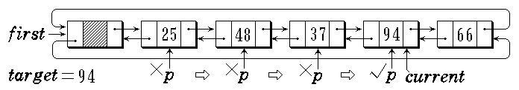
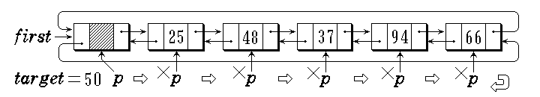
Doubly linked lists:Searching
Data Structure
Software College Northeastern University

Slide 59
Doubly Linked Lists:searching
public boolean find(Object o){
DblNode<Type> p = first.rLink;
if(o == null)
while( p != first && p.data != null) p = p.rLink;
else
while( p != first && !o.equals(p.data)) p = p.rLink;
if ( p != first){
current = p;
return true;
}
else return false;
}
Another method?
Data Structure
Software College Northeastern University

Slide 60
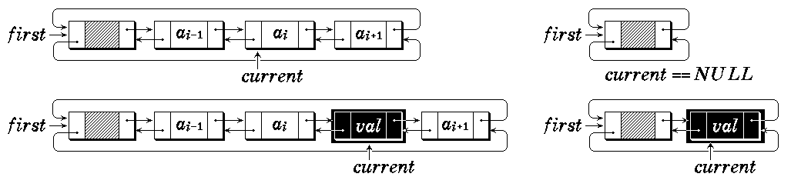
Doubly Linked Lists:Inserting
p.lLink = current;
p.rLink =current.rLink;
current.rLink = p;
current = current.rLink;
current.rLink.lLink = current;
3
2
1
5
Data Structure
Software College Northeastern University
4

Slide 61
Doubly Linked Lists:Inserting
public void insert ( const Type & value ) {
if ( current == null ) //在表首插入
current = first.rLink =
new DblNode ( value, first, first.rLink);
else { //在current结点后插入
current.rLink =new DblNode
( value, current, current.rLink );
current = current.rLink;
}
current.rLink.lLink = current;
}
Data Structure
Software College Northeastern University

Slide 62
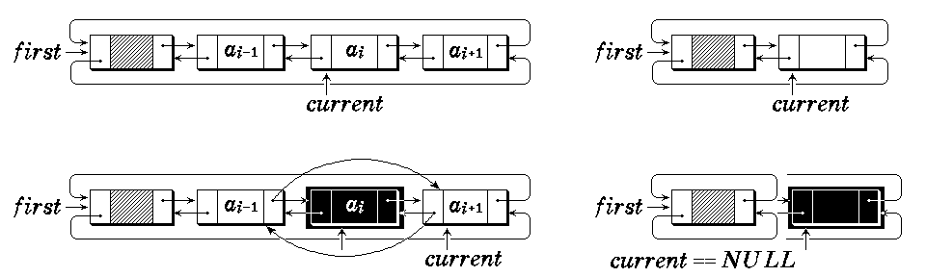
Doubly Linked Lists:Deleting
current.rLink.lLink = current.lLink;
Current.lLink.rLink = current.rLink;
2
1
Data Structure
Software College Northeastern University

Slide 63
Doubly Linked Lists:Deleting
public void remove(){
if ( current != null ) {
DblNode<Type> temp = current; //被删结点
current = current.rLink; //下一结点
current.lLink = temp.lLink; //从链中摘下
temp.lLink.rLink = current;
if ( current == first )
if ( isEmpty ( ) ) current = null;
else current = current.rLink;
}
}
Data Structure
Software College Northeastern University

Slide 64
Implementation of Doubly linked lists
public boolean first( ){
if ( !isEmpty ( )) { current = first.rLink; return true; }
current = null; return false;
}
public boolean next ( ) {
if ( current.rLink == first ){ current = null; return false; }
current = current.rLink; return true;
}
public boolean prior ( ) {
if ( current.lLink == first ){ current = null; return false; }
current = current.lLink; return true;
}
Data Structure
Software College Northeastern University

Slide 65
DLL compared to SLL
Advantages:
  Can be traversed in either direction (may be essential for some programs)
  Some operations, such as deletion and inserting before a node, become easier
Disadvantages:
  Requires more space
  List manipulations are slower (because more links must be changed)
  Greater chance of having bugs (because more links must be manipulated)
Data Structure
Software College Northeastern University

Slide 66
Overview
Linked Lists
Programming details
Circularly Linked Lists
Doubly Linked Lists
Cursors Implementation of Linked Lists
Applications
Multilists
Data Structure
Software College Northeastern University

Slide 67
Linked Lists: Cursor Implementation
Problem:
Inserting or Deleting use new and garbage collection mechanism to obtain and release a piece of space
dynamic management
If operations of getting or returning are frequently, it may indicate more time required
Two resolving way:
Cursor Implementation of linked lists using static memory
Initially we allocate many nodes to linked into spare lists
Data Structure
Software College Northeastern University

Slide 68
Linked Lists: Cursor Implementation
Tow important features of linked list:
The data are stored in a collection of structure, each structure contains data and a reference to the next structure
A new structure can be obtained from the system’s global memory by a call to new and released by garbage collection mechanism
Implementation:
Have a global array of structure
Array index can be used in place of a reference
Data Structure
Software College Northeastern University

Slide 69
Linked Lists: Cursor Implementation
Global array of structures
reference: Array index
public class StaticLink<Type>{
private static class Node<Type>{
//相当于链表中的结点
Type data;
int next;
}
private Node[] nodes;
private int free = 0;
//当前空闲结点的下标
private int size = 0;
//当前链表中存储数据个数
...
0 |  | 1
1 |  | 2
2 |  | 3
3 |  | 4
4 |  | 5
5 |  | 6
6 |  | 7
7 |  | 8
8 |  | 9
9 |  | 10
10 |  | 0
Data Structure
Software College Northeastern University

Slide 70
Linked Lists: Cursor Implementation
header
free list header: current
0 |  | 0
1 |  | 2
2 |  | 3
3 |  | 4
4 |  | 5
5 |  | 6
6 |  | 7
7 |  | 8
8 |  | 9
9 |  | 10
10 |  | 0
Simulation of new and free in cursor space array:
This list: Use cell 0 as the header of this list
freeList: cells that are not used, Use current as the header of freeList
A value of 0 for next is equivalent to null
How to initiate of freeList:
for(int i=1;i<nodes.length-1;i++)
nodes[i].next = i+1;
nodes[length-1].next = 0;
current = 1;
Data Structure
Software College Northeastern University

Slide 71
Linked Lists: Cursor Implementation
Use newNode get a new node for this list
0
1
2
3
4
5
6
7
8
9
10
header | 0
current | 2
 | 3
 | 4
 | 5
 | 6
 | 7
 | 8
 | 9
 | 10
 | 0
0
1
2
3
4
5
6
7
8
9
10
header | 1
newnode | 0
current | 3
 | 4
 | 5
 | 6
 | 7
 | 8
 | 9
 | 10
 | 0
Data Structure
Software College Northeastern University

Slide 72
Linked Lists: Cursor Implementation
int newNode( )
{ //allocate a cell from freelist
int p = current;
if(p!=0)
current = nodes[current].next;
return p;
} //end of newNode()
Data Structure
Software College Northeastern University

Slide 73
Linked Lists: Cursor Implementation
Use freeNode to release a removed node
0
1
2
3
4
5
6
7
8
9
10
header | 1
a | 2
c | 3
b | 4
e | 5
g | 6
f | 7
d | 0
current | 9
 | 10
 | 0
0
1
2
3
4
5
6
7
8
9
10
header | 1
a | 2
c | 3
b | 5
current | 8
g | 6
f | 7
d | 0
 | 9
 | 10
 | 0
Data Structure
Software College Northeastern University

Slide 74
Linked Lists: Cursor Implementation
void freeNode(int p)
{ //release a cell to freeList
nodes[p].next = current;
current = p;
} //end of freeNode
Data Structure
Software College Northeastern University

Slide 75
Linked Lists: Cursor Implementation
public boolean add(Type data, int index){
//在第index结点后插入数据
int p = find(index); //p为第index结点
if(p==0) return false;
int q = newNode();
if(q==0) return false;
nodes[q].data = data;
nodes[q].next = nodes[p].next;
nodes[p].next = q;
return true;
}
public boolean remove(int index){
…
}
Data Structure
Software College Northeastern University

Slide 76
Overview
Linked Lists
Programming details
Circularly Linked Lists
Doubly Linked Lists
Cursors Implementation of Linked Lists
Applications
Multilists
Data Structure
Software College Northeastern University

Slide 77
Linked Lists: Polynomial Implementation
class Term {
int coef;
int exp;
Term ( int c, int e ) { coef = c; exp = e; }
}
public class Polynomial {
LinkedList<Term> poly;
public Polynomial add(Polynomial p) {…} //加法
…
}
Unbounded
Convenient to insert or delete
Data Structure
Software College Northeastern University

Slide 78
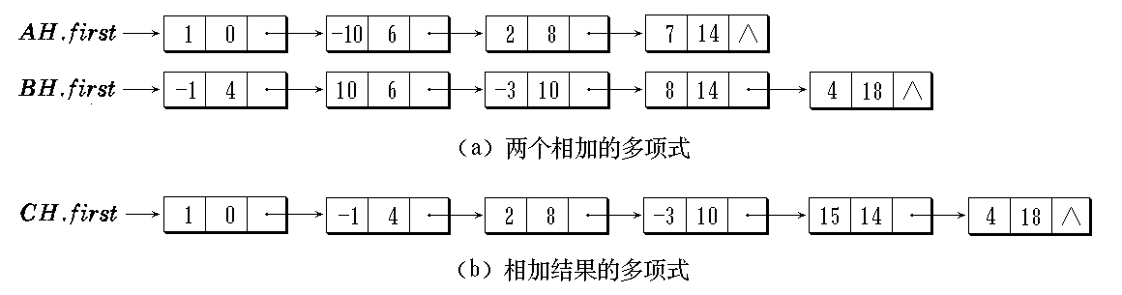
Polynomial Implementation:Adding
AH = 1 - 10x⁶ + 2x⁸ +7x¹⁴
BH = - x⁴ + 10x⁶ - 3x¹⁰ + 8x¹⁴ +4x¹⁸
Data Structure
Software College Northeastern University

Slide 79
Polynomial Implementation:Adding
public Polynomial add( Polynomial p) {
//返回两个多项式加法的结果
Polynomial c;
ListIterator<Term> aIter( this.poly );
ListIterator<Term> bIter( p.poly );
aIter.begin();
bIter.begin();
while(aIter.hasNext() && bIter.hasNext()){
Term ta = aIter.getData();
Term tb = bIter.getData();
Data Structure
Software College Northeastern University

Slide 80
Polynomial Implementation:Adding
if (ta.exp==tb.exp) {
int coef = ta.coef + tb.coef;
if(coef!=0) c.addTerm(new Term(coef, ta.exp));
aIter.next();
bIter.next();
}
if (ta.exp>tb.exp) {
c.addTerm(new Term(tb.coef, tb.exp));
bIter.next();
}
if (ta.exp<tb.exp) {
c.addTerm(new Term(ta.coef, ta.exp));
aIter.next();
}
}
Data Structure
Software College Northeastern University

Slide 81
Polynomial Implementation:Adding
while( aIter.hasNext() ){
Term ta = aIter.getData();
c.addTerm(new Term(ta.coef, ta.exp));
aIter.next();
}
while( bIter.hasNext() ){
Term tb = bIter.getData();
c.addTerm(new Term(tb.coef, tb.exp));
bIter.next();
}
return c;
}
Data Structure
Software College Northeastern University

Slide 82
Overview
Linked Lists
Programming details
Circularly Linked Lists
Doubly Linked Lists
Cursors Implementation of Linked Lists
Applications
Multilists
Data Structure
Software College Northeastern University

Slide 83
Multilists
We can get even more complicated.
  Suppose we have 11,000 students and 600 courses at this university. We want to record every course that a student takes and record every student in a class. This would require an 11,000 x 600 array, which is huge. Furthermore, most of the entries in the array would be empty!
C1 C2………………………………………….
S1
S2
S3
S4
S5
.
.
Data Structure
Software College Northeastern University

Slide 84
Use Multilists Instead
C1
Cm
S1
S2
Sn
Data Structure
Software College Northeastern University

Slide 85
Multilists continued…
To see which students are in course C1, we simply go down the first column of the multilist.
To see which courses student S1 is taking, we simply go along the first row of the multilist.
Data Structure
Software College Northeastern University

Slide 86
Sparse Matrix:array of Triple
6
7
8
A.rows
A.columns
A.Terms
A.elem
0 12 9 0 0 0 0
0 0 0 0 0 0 0
-3 0 0 0 0 14 0
0 0 24 0 0 0 0
0 18 0 0 0 0 0
15 0 0 -7 0 0 0
Changes to 17
A =
row col value
0
1
2
3
4
5
6
7
8
0 1 12
Inserting
(3,5,17)
2 2 9
2 0 -3
2 5 14
3 2 24
4 1 18
Problem:
It’s Hard to
insert and remove element.
5 0 15
5 3 -7
Data Structure
Software College Northeastern University

Slide 87
Multilists:Node
head
next
head
row
col
down
right
down
value
right
(a) 表头结点 (b) 非零元素结点
False
i
j
a[i][j]
(c) 建立a[i][j]结点
Data Structure
Software College Northeastern University

Slide 88
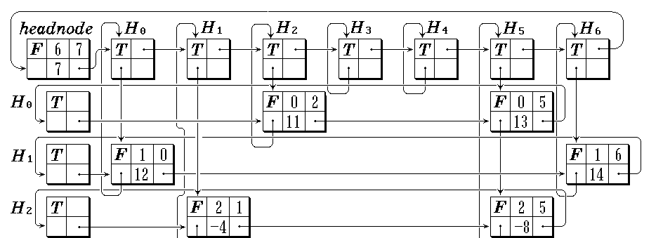
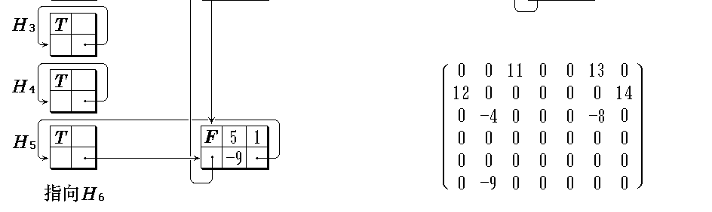
Multilists
Data Structure
Software College Northeastern University

Slide 89
LinkedList is Java
Interface Iterable<T>
public interface Iterable<T> : Implementing this interface allows an object to be the target of the "foreach" statement.
Methods:
Iterator<T> iterator() : Returns an iterator over a set of elements of type T.
public interface Collection<E>: extends Iterable<E>
Iterator<E> iterator() :Returns an iterator over the elements in this collection.
Data Structure
Software College Northeastern University

Slide 90
LinkedList is Java
public Interface Iterator<E> : An iterator over a collection.
Methods:
boolean hasNext();
E next();
void remove();
public interface ListIterator<E> extends Iterator<E> : An iterator for lists that allows the programmer to traverse the list in either direction, modify the list during iteration, and obtain the iterator's current position in the list.
Methods:
void add(E e);
boolean hasPrevious();
int nextIndex();
E previous();
int previousIndex();
void set(E e);
Data Structure
Software College Northeastern University

Slide 91
LinkedList is Java
public ListIterator<E> listIterator(int index) {
return new ListItr(index);
}
private class ListItr implements ListIterator<E> {
private Node<E> lastReturned;
private Node<E> next;
private int nextIndex;
ListItr(int index) {
// assert isPositionIndex(index);
next = (index == size) ? null : node(index);
nextIndex = index;
}
...
}

Slide 92
LinkedList is Java
Java.util.LinkedList<E> : Doubly-linked list implementation of the List interfaces. Implements all optional list operations, and permits all elements (including null).
Methods:
  int size();
  void clear();
  E get(int index);
  E set(int index, E element);
  boolean add(E e);
  void add(int index, E element);
  E remove(int index);
  boolean remove(Object o);
  int indexOf(Object o);

Slide 93
LinkedList is Java
import java.util.*;
public static void main(String[] args) {
ArrayList<String>list = new ArrayList<String>();
list.add("Collection");
list.add("List");
list.add(“LinkedList");
for(int i=0; i<list.size(); i++)
System.out.println(list.get(i));
list.remove(1);
for(String str: list)
System.out.println(str);
}

Slide 94
Exercises
1.Write a function to add two polynomials, Do not destroy the input. Use a linked list implementation. If the polynomials have M and N terms respectively, What is the time complexity of your program?
2.Write a program to find a particular element in a singly linked list. Do this both recursively and non-recursively, and compare the running times, How big does the list have to be before the recursive version crashes?
3.Write a nonrecursive procedure to reverse a single linked list in O(N) time using constant extra space.
Data Structure
Software College Northeastern University

Slide 95
Exercises
4.An Alternative to deletion strategy we have given is to use lazy deletion. to delete an element, we merely mark it deleted (using an extra bit field). The number of deleted and non-deleted elements in the list is kept as part of the data structure. If there are as many as deleted elements as nondeleted elements, we traverse the entie list, performing the standard deletion algorithm on all marked nodes.
a) List the advantages and disadvantages of lazy deletion.
b) Write routines to implement the standard linked list operations using laze deletion.
Data Structure
Software College Northeastern University

